Slide 1
C/C++ 生物信息学编程
第二课：C++面向对象编程

Slide 2

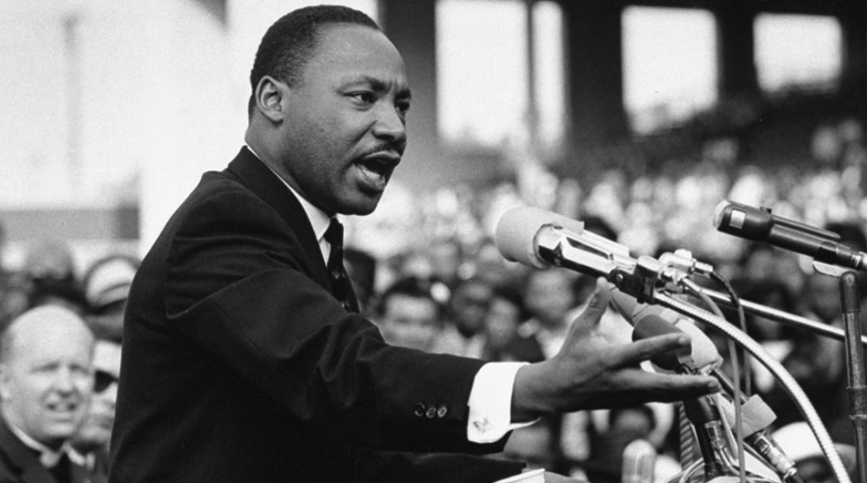
“
所谓面向对象编程，就是把电脑想像成你的对象，面对着它编程！
－Manu Ginobili 发现了面向对象编程的真谛

Slide 3
物以类聚，人以群分

Slide 4
C++: Object-Oriented Programming
OOP combines the data and functions that manipulate the data into a single package called objects.
Data – The object’s attributes
Functions – The object’s behavior
The “Packages” have the favorable Software Engineering property of Information Hiding
Objects know how to communicate with each other via well-defined interfaces
Implementation details are hidden

Slide 5
C++: Object-Oriented Programming
C++ is a language that allows you to program using the OOP style.
You can program in C++ using non-OOP styles.
In OOP the unit of programming is called a class.
An object is an item that is an instantiation (actually define a variable ) of a class.
Remember that a class has both data and functions combined.

Slide 6
C++: Object-Oriented Programming
C++ Classes
A programmer creates their own user-defined types called classes.
Classes do not set aside storage or define variables. They only tell the compiler what a class looks like.
These are also called programmer-defined types.
Each class contains data and functions to manipulate the data
Data components of a class are called data members.
Function are called member functions.
An instance of a user-defined type is called an object.

Slide 7
C++: Object-Oriented Programming
So what is the difference:
In C, Data and functions are always separate
In C++, you can build objects that have both the data and functions put together.
C++ Libraries can contain useful classes that store data in useful and reusable ways. Classes then become the building blocks for more complex programs.

Slide 8
C++: Object-Oriented Programming
There are three parts in a C++ program related to objects:
DDU
Declare: Define the types of data that will be used, give them names, declare the functions and their interface.
Define: Put the details into the class. Write the code and the implementation details.
Use: The actual code that uses the class.

Slide 9
C++: Object-Oriented Programming
Protected levels in a class:
Public: Can be accessed both within and external to the object.
Private: Can only be used by the object itself.
The public section of a class is usually called the interface. It is what the programmers sees.
Normally, all data is private and only the bare essential functions are made public.

Slide 10
C++: Object-Oriented Programming
Reasons for hiding
Reduces complexity much like the detailed workings of an automobile are hidden from the average driver.
Principle of least privilege (need-to-know)
More Secure. Less likely that someone will alter or misuse something.
Easier to change the implementation without affecting other modules that use it.

Slide 11
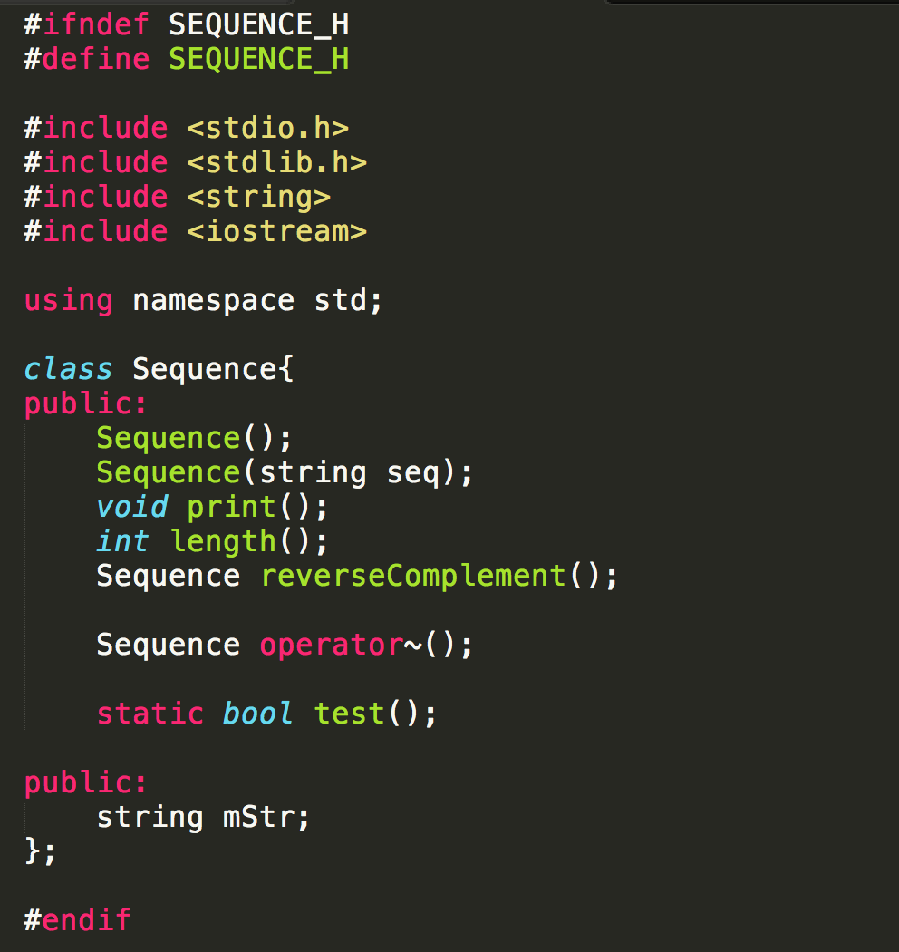
C++: Object-Oriented Programming
← sequence.h

Slide 12
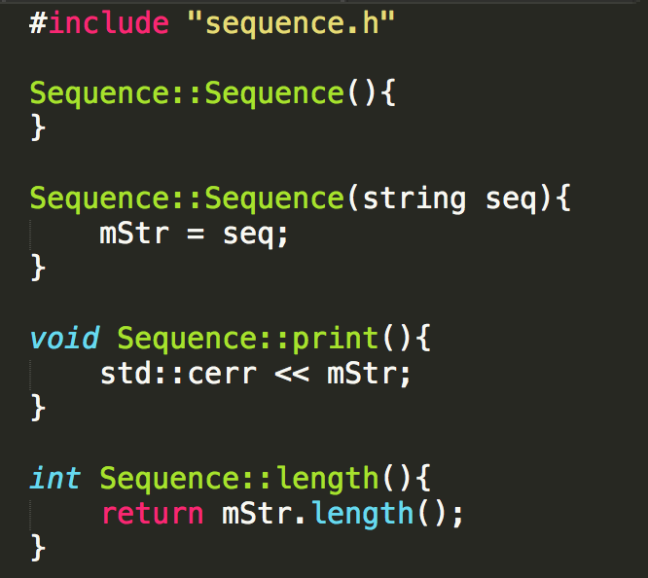
C++: Object-Oriented Programming
← sequence.cpp

Slide 13
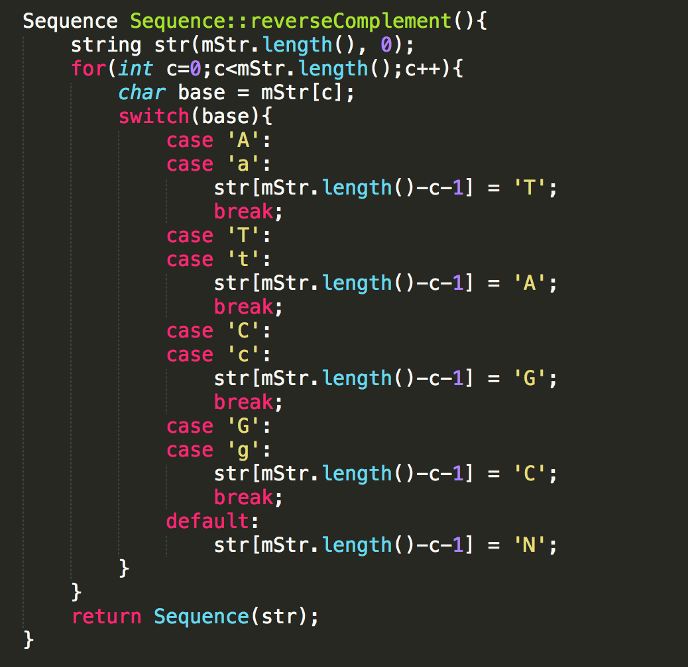
C++: Object-Oriented Programming
← sequence.cpp

Slide 14
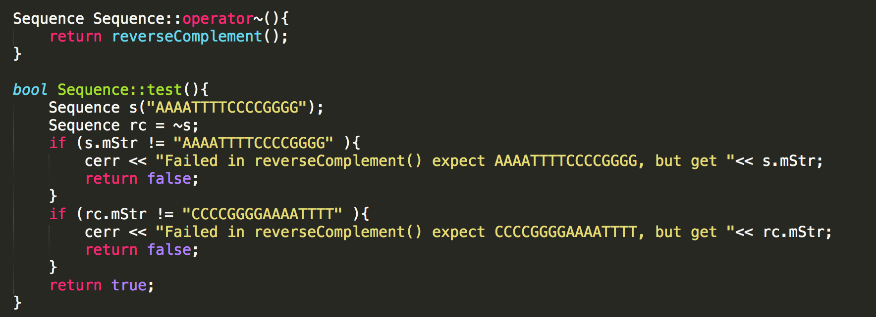
C++: Object-Oriented Programming
← sequence.cpp

Slide 15
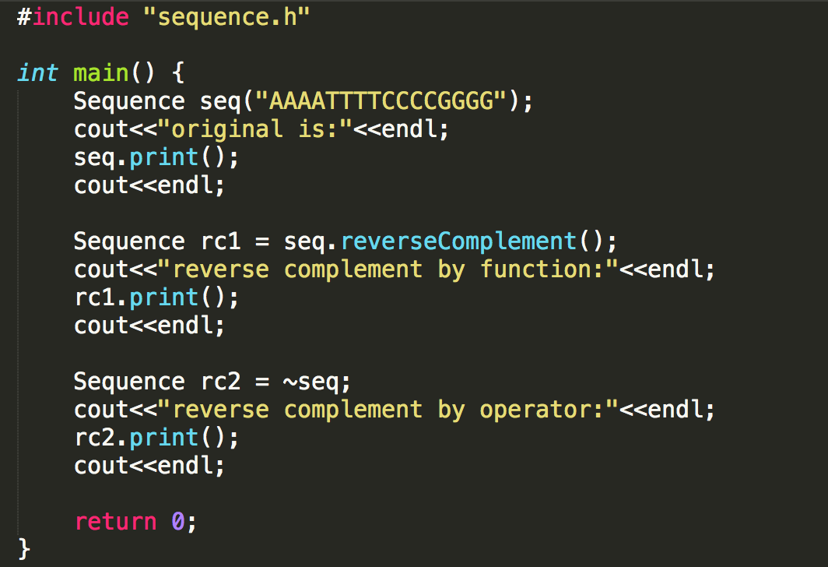
C++: Object-Oriented Programming
← main.cpp

Slide 16
练习一
编写一个Sequence类 (sequence.cpp, sequence.h)， 和一个main，实现简单的功能

Slide 17
编译并运行
g++ main.cpp sequence.cpp –o program
./program

Slide 18
编译并运行：结果
original is:
AAAATTTTCCCCGGGG
reverse complement by function:
CCCCGGGGAAAATTTT
reverse complement by operator:
CCCCGGGGAAAATTTT

Slide 19
课后项目
X04 /haplox/cpp/dna.txt 是一个存储DNA序列的文本文件，每一行100个字符，大小可能会超过数M大小 ，里面只有四种不同的字符（A,T,C,G），即四种核甘酸
作业的内容是要求写一个类 Sequence，这个类提供了以下方法：
Sequence(string filename); 构造函数，只接受一个文件名为参数
int length(); 获得序列的长度，注意要把回车符去掉
int numberOf(char base); 获得某种核甘酸的个数, 其中的参数base为A, T, C, G 的一种
string longestConsecutive(); 获得最长的连续的碱基的序列，如果有两个是一样长的，则返回位置靠前的
例如文件内容是ATCCCTAGGGGGGCT，则返回GGGGGG
string longestRepeated(); 如果该文件中，存在两个不同位置的子序列A和B一模一样，则称它们为Repeated，返回最长的子序列
例如文件内容是CATCGGCTATTTATCGGCTATG，则返回ATCGGCTA

Slide 20
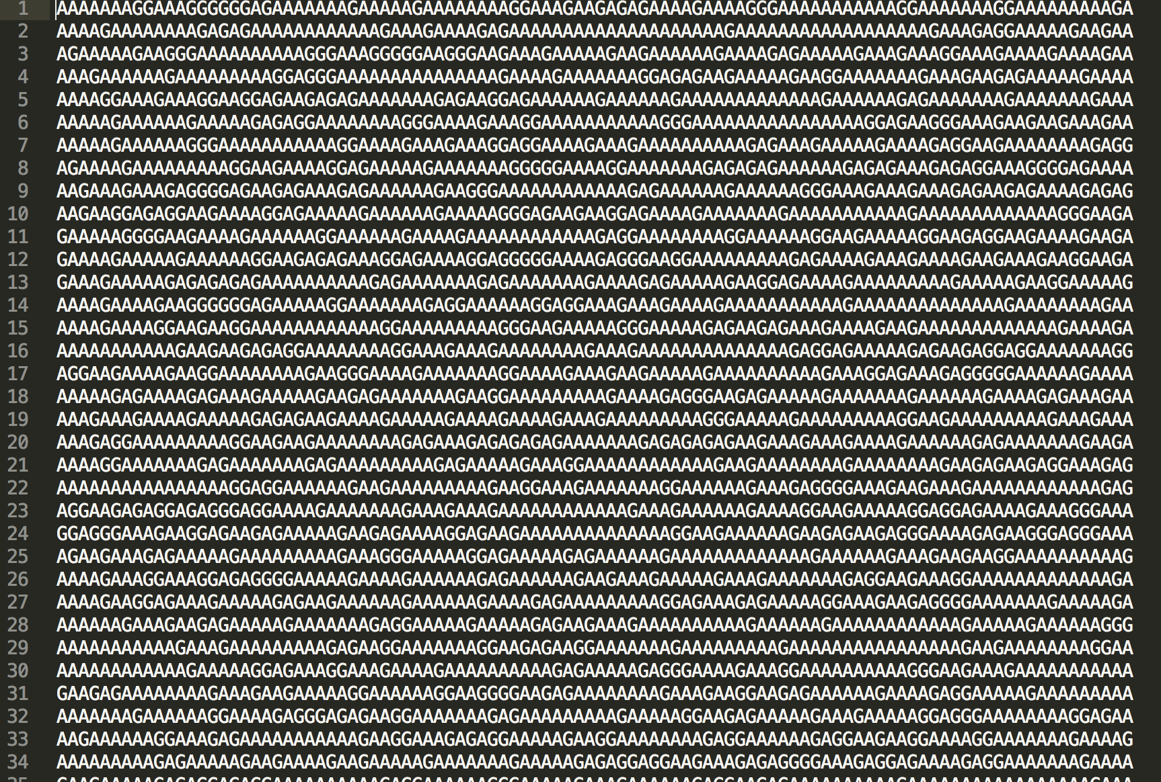
文件格式

Slide 21
评分准则
总分100分计：
Sequence(string filename); 类结构完整，所有方法都存在：20分
int length(); 获得序列的长度：结果正确10分
int numberOf(char base); 获得某种核甘酸的个数, 其中的参数base为A, T, C, G 的一种：结果正确 10分
string longestConsecutive(); 获得最长的连续的碱基的序列，如果有两个是一样长的，则返回位置靠前的
结果正确20分，函数计算在1秒钟内完成10分
string longestRepeated(); 如果该文件中，存在两个不同位置的子序列A和B一模一样，则称它们为Repeated，返回最长的子序列
结果正确20分，函数计算在10秒钟内完成10分
如果作弊，得0分！

Slide 22
得分在下一次团建中有用

Slide 23


用 / 编程语言 / 解读 / 生命的语言
用 / 数理逻辑 / 探究 / 上帝的逻辑

